Slide 1
Project Presentation
3D Object Detection(Waymo)
Jay Patel
Rutvik Patel

Slide 2
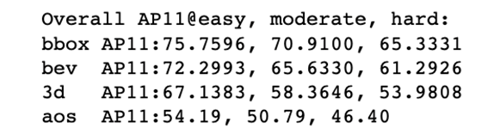
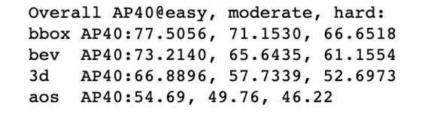
Project Progress
Trained point pillars(MMDetection3D) on kitti dataset with secfpn backend and 25 epochs.
Results:
Made an attempt to train the model on Waymokitti dataset.
Getting data folder velodyne_reduced not found error.

Slide 3
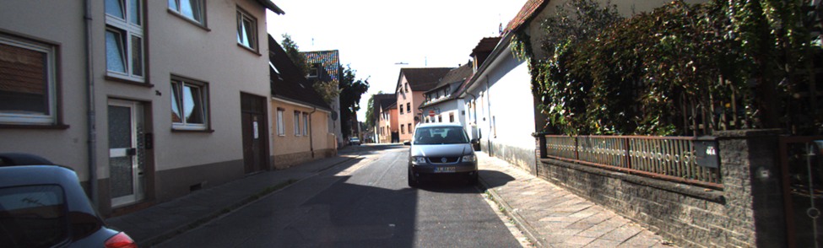
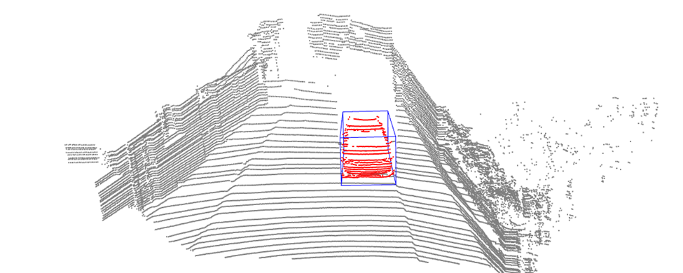
Point pillar training on kitti dataset

Slide 4
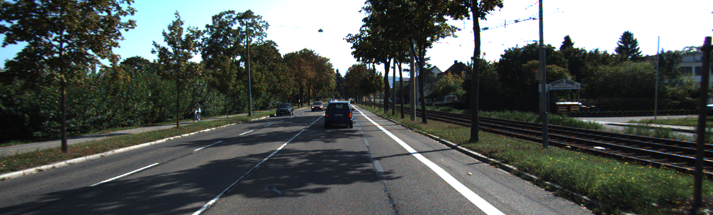
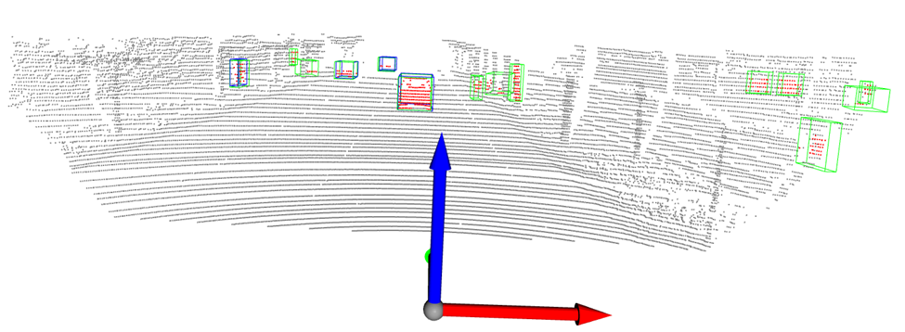
PointPillar testing on kitti dataset

Slide 5
3D Object Detection
There are two main detection directions for object detection in Lidar information.
1. Project a 3D point cloud to a 2D image (fast speed, high reference resources,low precision)
2. Feature extraction directly using 3D point clouds (high accuracy, low inference speed)

Slide 6
3D Object Detection
The PointPillars method (abbreviated as PP) is quite excellent.
The accuracy of the classification of the vehicle category is roughly equivalent to CONTFUSE, but the inference speed can reach 60hz far higher than other networks.
PointPillars run at 62 fps which is orders of magnitude faster than the previous works in this area.
Near-real-time object detection of point cloud data is almost possible.

Slide 7
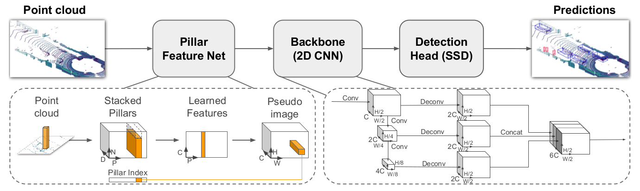
PointPillar Architecture

Slide 8
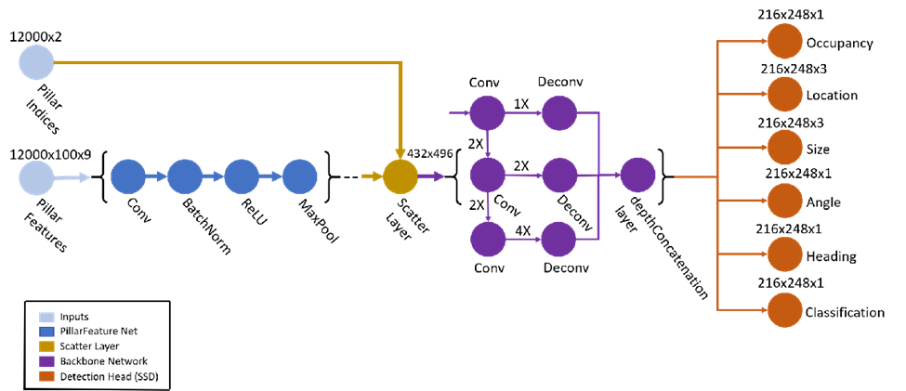

Point Pillar : layers
Notes:
A PointPillars network requires two inputs: pillar indices as a P-by-2 and pillar features as a P-by-N-by-K matrix.
P is the number of pillars in the network,
N is the number of points per pillar,
and K is the feature dimension.
The network begins with a feature encoder, which is a simplified PointNet. It contains a series of convolution, batch-norm, and relu layers followed by a max pooling layer. A scatter layer at the end maps the extracted features into a 2-D space using the pillar indices.
Next, the network has a 2-D CNN backbone that consists of encoder-decoder blocks. Each encoder block consists of convolution, batch-norm, and relu layers to extract features at different spatial resolutions. Each decoder block consists of transpose convolution, batch-norm, and relu layers.
The network then concatenates output features at the end of each decoder block, and passes these features through six detection heads with convolutional and sigmoid layers to predict occupancy, location, size, angle, heading, and class.

Slide 9
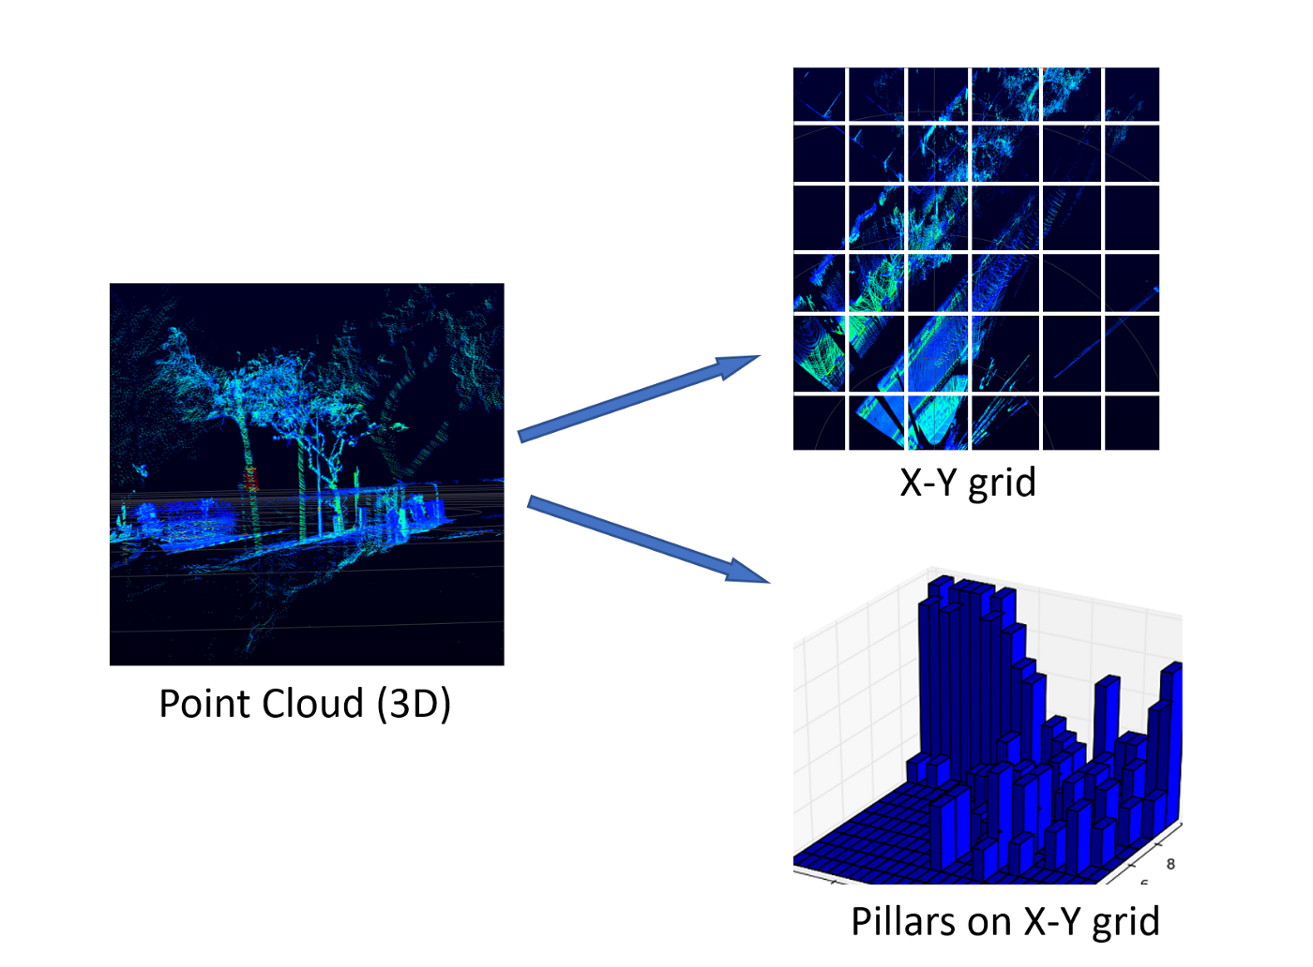
Feature Encoder (Pillar feature net)
Converts the point cloud into a sparse pseudo image. First, the point cloud is divided into grids in the x-y coordinates, creating a set of pillars. Each point in the cloud, which is a 4-dimensional vector (x,y,z, reflectance), is converted to a 9-dimensional vector containing the additional information explained as follows:
Xc, Yc, Zc = Distance from the arithmetic mean of the pillar c the point belongs to in each dimension.
Xp, Yp = Distance of the point from the center of the pillar in the x-y coordinate system.
Hence, a point now contains the information D = [x,y,z,r,Xc,Yc,Zc,Xp,Yp].

Slide 10
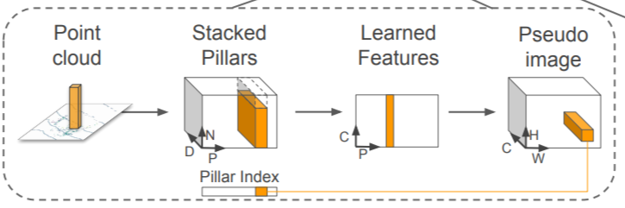
From pillars to a dense tensor(stacked pillars)
The set of pillars will be mostly empty due to sparsity of the point cloud, and the non-empty pillars will in general have few points in them. This sparsity is exploited by imposing a limit both on the number of non-empty pillars per sample (P) and on the number of points per pillar (N) to create a dense tensor of size (D, P, N). If a sample or pillar holds too much data to fit in this tensor the data is randomly sampled. Conversely, if a sample or pillar has too little data to populate the tensor, zero padding is applied.
Note that D = [x,y,z,r,Xc,Yc,Zc,Xp,Yp] as explained in the previous section.

Slide 11
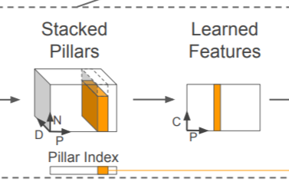
From Stacked Pillars to Learned Features
We use PointNet to extract features from a point cloud type of data.
PointNet basically applies to each point, a linear layer followed by BatchNorm and ReLU to generate high-level features, which in this case is of dimension (C,P,N). This is followed by a max pool operation which converts this (C,P,N) dimensional tensor to a (C,P) dimensional tensor.

Slide 12
Generating the Pseudo Image from Learned features
The generated (C, P) tensor is transformed back to its original pillar using the Pillar index for each point.
So originally, where the point was converted to a D dimensional vector, now it contains a C dimensional vector, which are the features obtained from a PointNet.

Slide 13
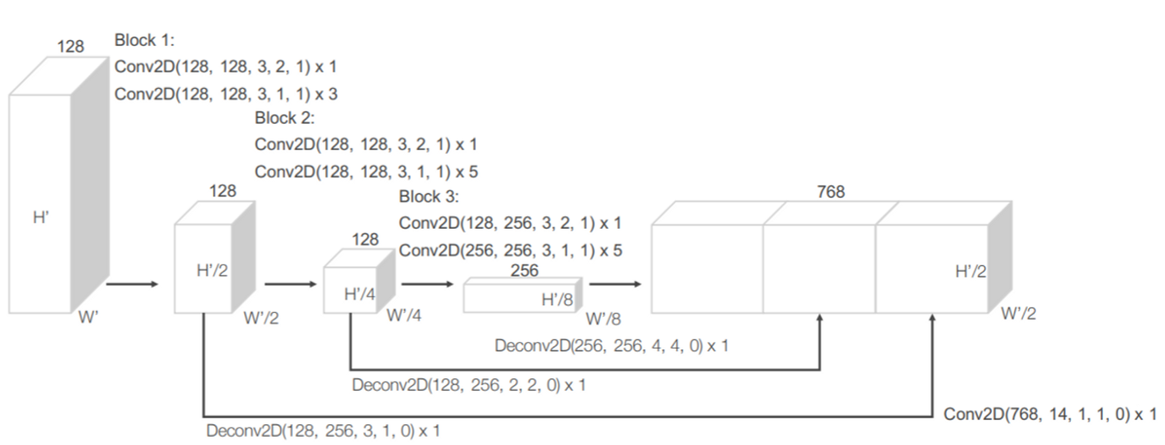
Backbone
An example of a backbone (RPN) Region Proposal Network used in Point Pillars.
Notes:
The backbone constitutes of sequential 3D convolutional layers to learn features from the transformed input at different scales. The input to the RPN is the feature map provided by the Feature Net. The architecture of this network is illustrated in the figure above. The network has three blocks of fully convolutional layers. The first layer of each block downsamples the feature map by half via convolution with a stride size of 2, followed by a sequence of convolutions of stride 1 (×q means q applications of the filter). After each convolution layer, BN and ReLU operations are applied. We then upsample the output of every block to a fixed size and concatenated to construct the high-resolution feature map.
ConvMD(cin, cout, k, s, p) to represent an M-dimensional convolution operator where cin and cout are the number of input and output channels, k, s, and p are the M-dimensional vectors corresponding to kernel size, stride size, and padding size respectively. When the size across the M-dimensions is the same, we use a scalar to represent the size e.g. k for k = (k, k, k).

Slide 14
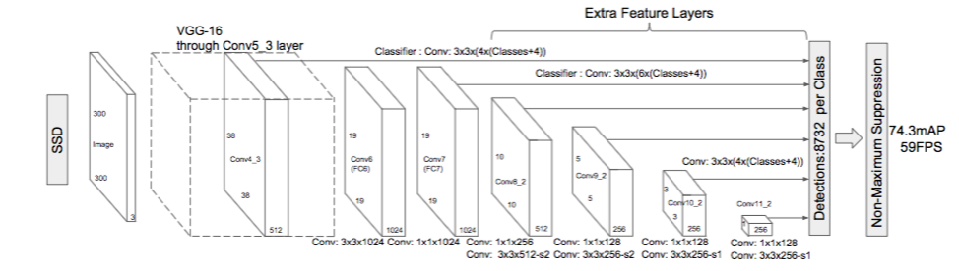
Detection Head (SSD)
The objective of the SSD network is to generate 2D bounding boxes on the features generated from the backbone layer of the Point Pillars network.
Notes:
Several important reasons for choosing SSD as a one-shot bounding box detection algorithm are:
Fast inference.
Uses features from well-studied networks like VGG.
Great Accuracy.
They modify the original VGG network, which is simply the scaled-down part of the image above to concatenate features from different scales. SSD uses priors for regressing the bounding box locations and then Non-Maximum suppression to filter out noisy predictions. If this stuff appears to be fuzzy, I highly recommend peeking at this post and it won’t take you much time when you’ll understand all of it. Also, since SSD was originally developed for images, to modify the predictions for 3D bounding boxes, the height and elevation were made additional regression targets in the network.

Slide 15
Detection Head(SSD) contd.
Several important reasons for choosing SSD as a one-shot bounding box detection algorithm are:
Fast inference.
Uses features from well-studied networks like VGG.
Great Accuracy.

Slide 16
References
Lang, Alex H., et al. “Pointpillars: Fast Encoders for Object Detection from Point Clouds.” 2019 IEEE/CVF Conference on Computer Vision and Pattern Recognition (CVPR), 2019, https://doi.org/10.1109/cvpr.2019.01298.

